Slide 1
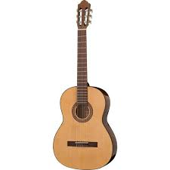
Guitar

Slide 2

Lesson objectives – Year 5 - guitar
performing
appraising
Greater Depth
Sing and use their understanding of meaning to add expression
Perform by ear and from simple notation
Improvise within a group, using rhythmic and melodic phrases
Recognise and use basic structural forms (eg. rounds, variations, rondo form)
Maintain your part, whilst others play their part
Choose the most appropriate tempo for a piece of music
Describe, compare and evaluate music, using musical notation
Suggest improvements to their own or other’s work
Use pitches simultaneously to produce harmony by building up simple chords
Devise and play a repeated sequence of pitches on a tuned instrument to accompany a song
Identify and use how patterns of repetitions, contrast and variations can be organized to give structure to a melody, rhythm, dynamic and timbre.
Explain how tempo changes the character of the music
Understand the relation between pulse and syncopated patterns
Identify where a gradual change in dynamics has helped to shape a piece of music

Slide 3
Vocabulary accent adagio allegro bass crescendo notation semibreves semiquavers texture timbre

Slide 4
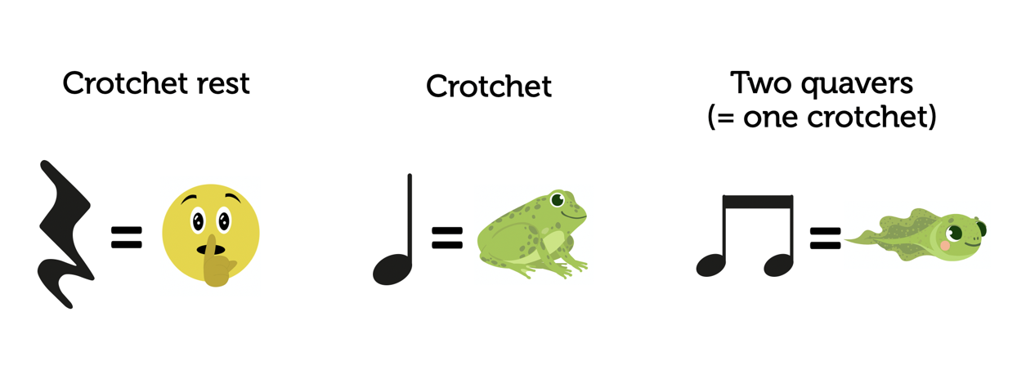

Slide 5
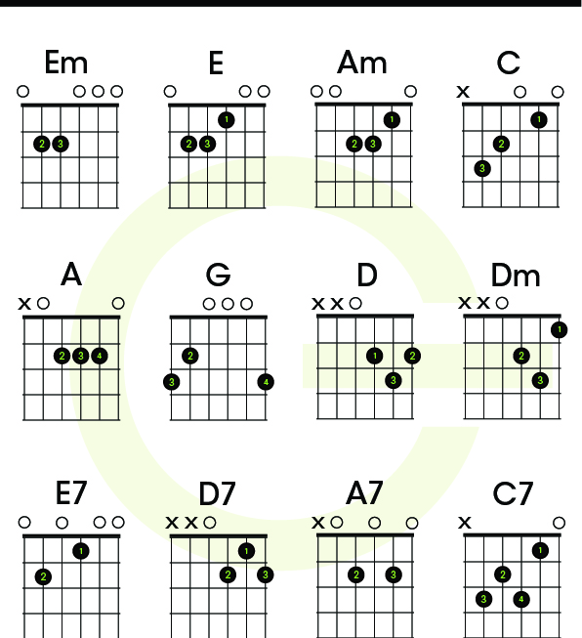
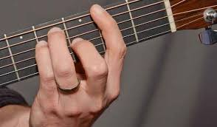
Basic Guitar Chords

