Slide 1
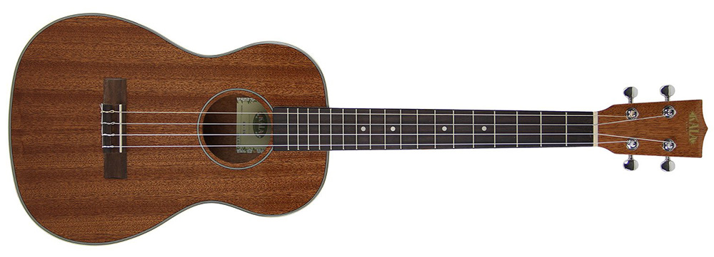
Ukulele

Slide 2
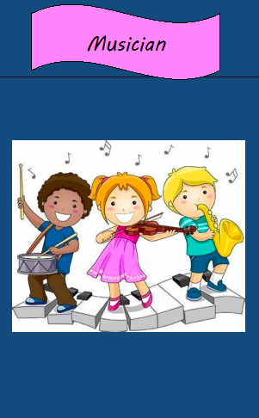
Lesson objectives – Year 4 - Ukelele
performing
appraising
composing
Greater Depth
Perform a simple part of an ensemble rhythmically
Sing songs from memory with increasing expression, accuracy and fluency
Improvise and use repeated patterns with increasing accuracy and fluency
Use notations to record and interpret sequences of pitches
Begin to use standard notation
Use notation in a performance
Combine groups of beats
Use musical words (pitch/duration/timbre/dynamics/tempo) to describe music
Show how you can use dynamics to provide contrast.
Identify how a change of timbre can change the effect of a piece of music

Slide 3
Vocabulary forte (loud) harmony improvise leaping (large interval between two notes) minim piano (quiet) pulse recorder score treble clef tuned percussion untuned percussion volume pentatonic

Slide 4
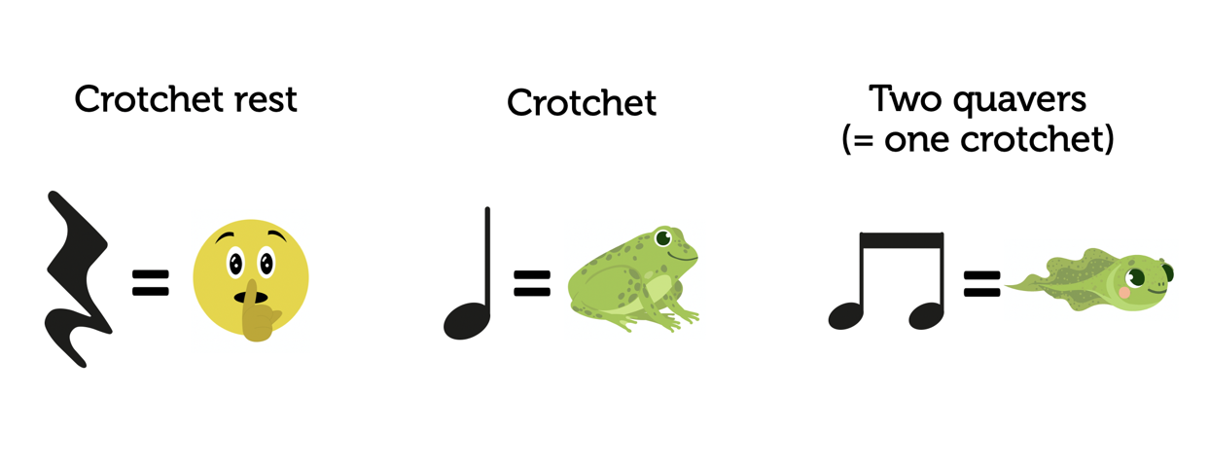

Slide 5
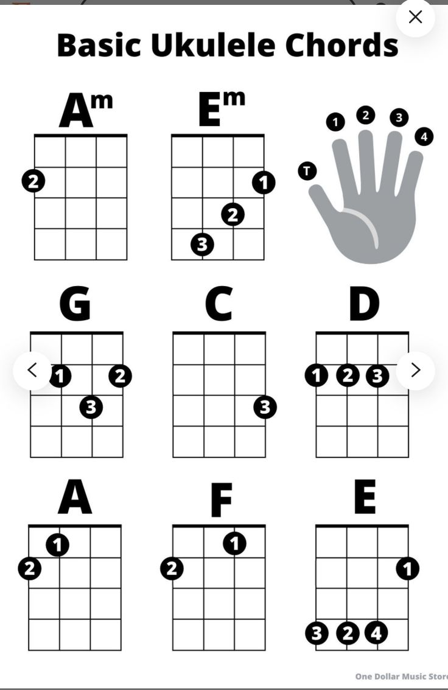
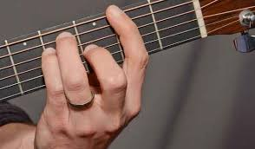
Basic Ukulele Chords

