Slide 1
Music Appreciation
KS1 – Spring 1

Slide 2
Week 1

Slide 3
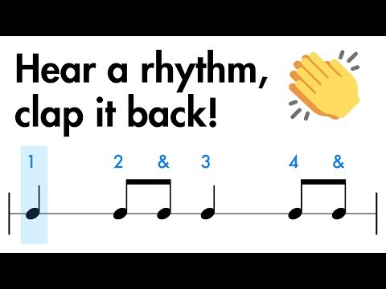
Clapping rhythms
Listen carefully
Can you remember what we did last term?
Can you repeat the patterns?

Slide 4
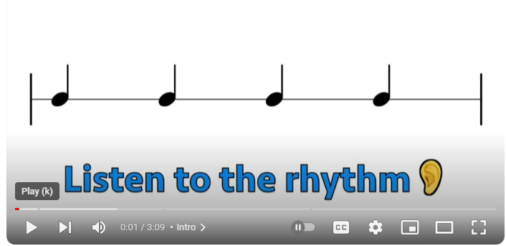

Slide 5
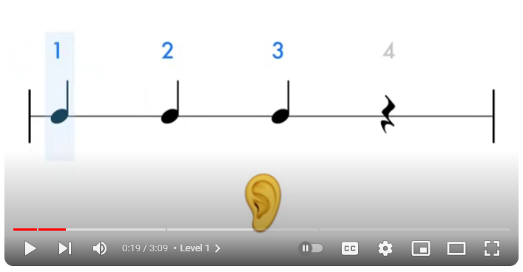

Slide 6
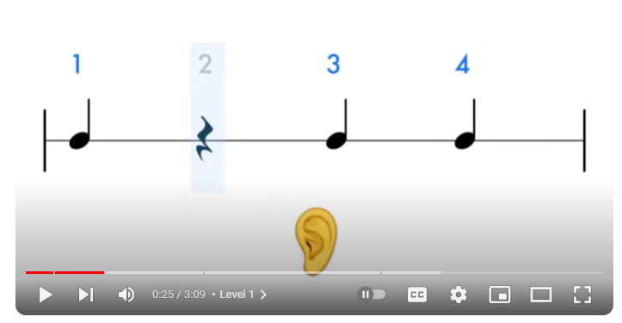

Slide 7
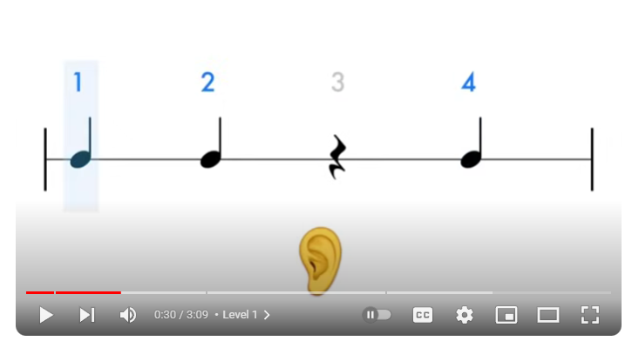

Slide 8
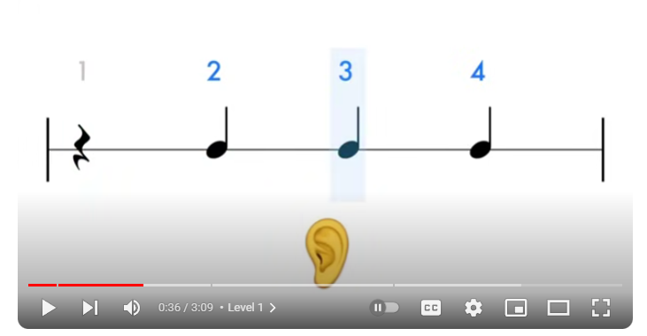

Slide 9
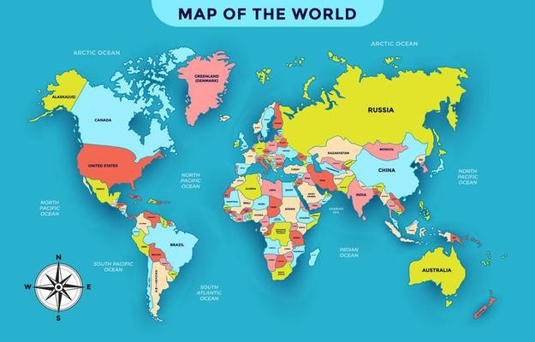
Reflection
Blues music originated in the Southern United States
Today we are going to listen to some popular music called:
Runaway Blues
By Ma Rainey
This type of music is called
Blues

Slide 10
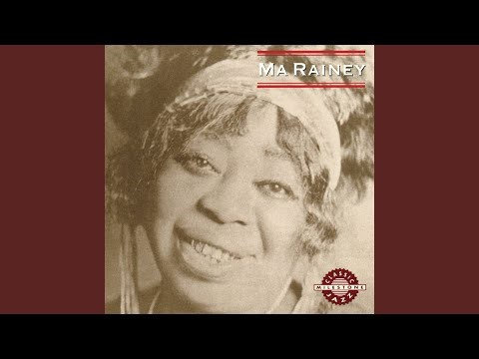
Reflection
What do you notice about the music?
Do you think there are clear parts to the music?
What are the differences within the piece of music?
Does it make you want to dance or does it make you think or feel something different?
https://www.youtube.com/watch?v=Fm5qmMRx20s

Slide 11
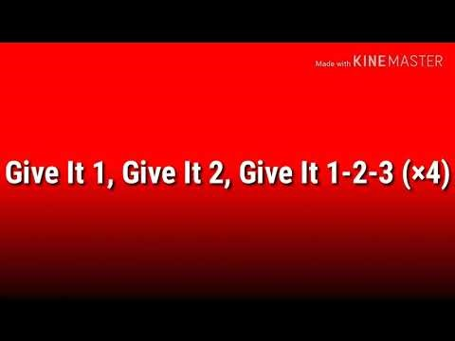
Hayfield Lane Song
https://www.youtube.com/watch?v=oJmyY2yR9sw

Slide 12
Week 2

Slide 13
Clapping rhythms
Listen carefully
Can you remember what we did last term?
Can you repeat the patterns?

Slide 19
Reflection
Blues music originated in the Southern United States
Can we remember what the music was called from last week?
Runaway Blues
By Ma Rainey
This type of music is called
Blues

Slide 20
Reflection
What do you notice about the music?
Does it make you want to dance or does it make you think or feel something different?
What do you think the message of the music is?
Is it something that you would choose to listen to? Why/why not?
https://www.youtube.com/watch?v=Fm5qmMRx20s

Slide 21
Hayfield Lane Song
https://www.youtube.com/watch?v=oJmyY2yR9sw

Slide 22
Week 3

Slide 23
Clapping rhythms
Listen carefully
Can you repeat the patterns?

Slide 29
Reflection
Gamelan is from Indonesia
This week the music is Traditional music from Bali in Indonesia
Baris
By Gong Kebyar of Peliatan
This type of music is called
Gamelan

Slide 30
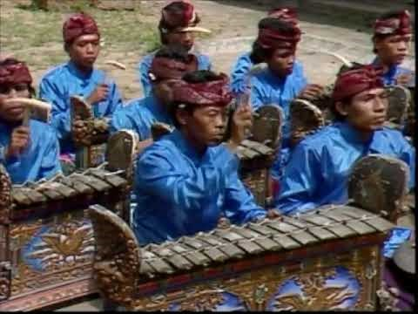
Reflection
What instruments can you see when you watch the video?
Are they ones we are familiar with or are there any you don’t know?
How is this music different from the blues we listened to last week?
https://www.youtube.com/watch?v=nGCSrC8RN6c

Slide 31
Hayfield Lane Song
https://www.youtube.com/watch?v=oJmyY2yR9sw

Slide 32
Week 4

Slide 33
Clapping rhythms
Listen carefully
Can you repeat the patterns?

Slide 39
Reflection
Gamelan is from Indonesia
This week the music is Traditional music from Bali in Indonesia
Baris
By Gong Kebyar of Peliatan
This type of music is called
Gamelan

Slide 40
Listen again
https://www.youtube.com/watch?v=nGCSrC8RN6c

Slide 41
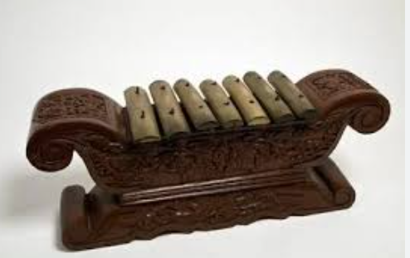
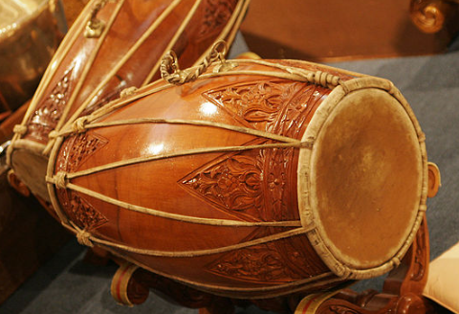
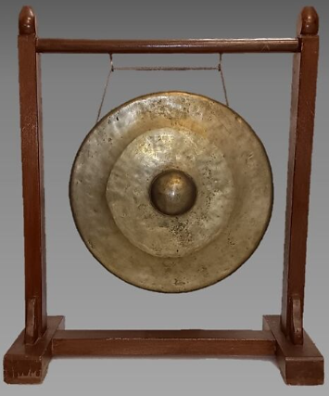
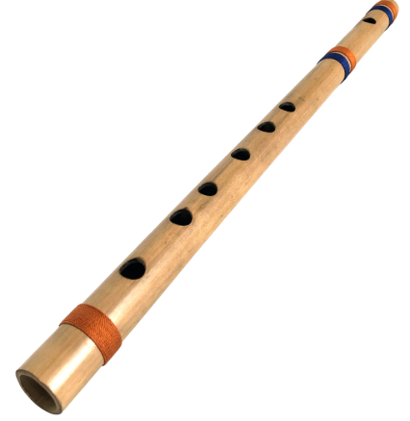
Can you remember what instruments you saw/heard in the music?
Look at the pictures, and similar examples that we have (physical instruments to hear the sound of)
Metallophone
Drum
Gong
Flute

Slide 42
Hayfield Lane Song
https://www.youtube.com/watch?v=oJmyY2yR9sw

Slide 43
Week 5

Slide 44
Clapping rhythms
Listen carefully
Can you remember what we did last term?
Can you repeat the patterns?

Slide 50
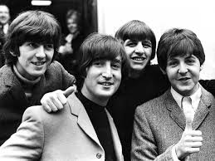
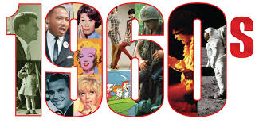
Reflection
This week the music is:
All you need is love
By The Beatles
This type of music is called
Pop Music
Pop music is a genre of popular music that originated in the 1950’s in the United States and the United Kingdom.
This song was released in 1967

Slide 51
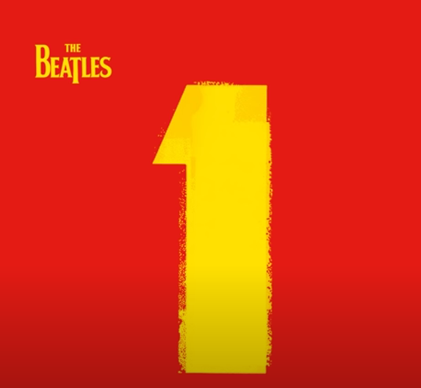
Reflection
What do you notice about the music?
How is it different to todays pop music?
Pause half way – can we clap along to the beat of the music?
(at the end) what is happening/what changes?
Is it tempo/dynamic/instruments/style? etc…
https://www.youtube.com/watch?v=4EGczv7iiEk

Slide 52
Hayfield Lane Song
https://www.youtube.com/watch?v=oJmyY2yR9sw

