Slide 1
Music Appreciation
KS1

Slide 2
Week 2

Slide 3
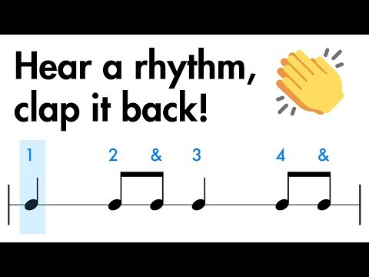
Clapping rhythms
Listen carefully
Can you complete level 1?

Slide 4
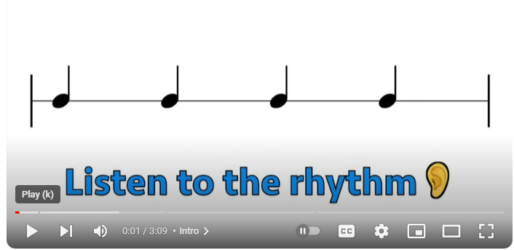

Slide 5
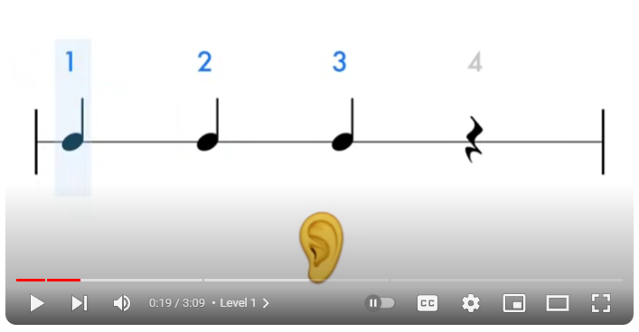

Slide 6
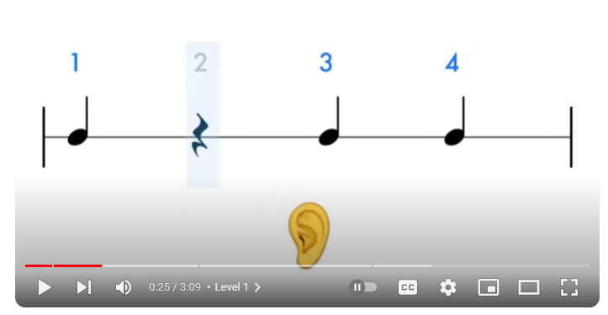

Slide 7
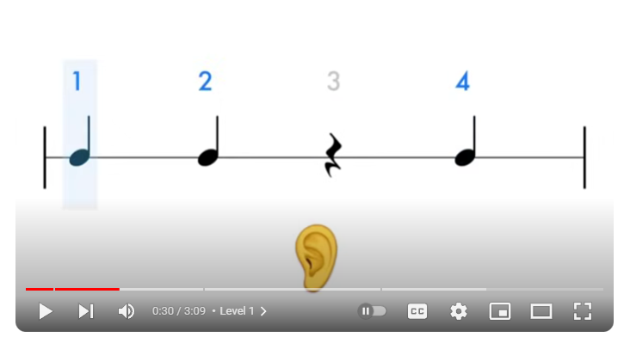

Slide 8
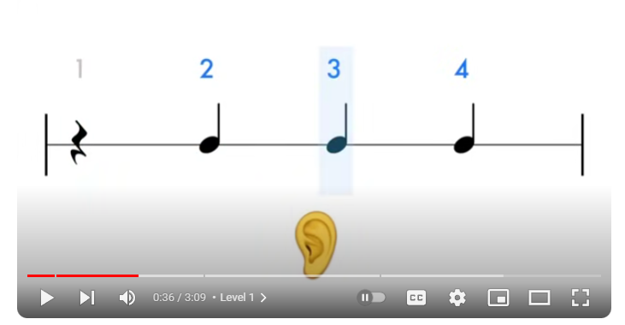

Slide 9

Today’s music
Listen to the music
Has anyone heard it before?
Do you recognise where it is from?

Slide 10
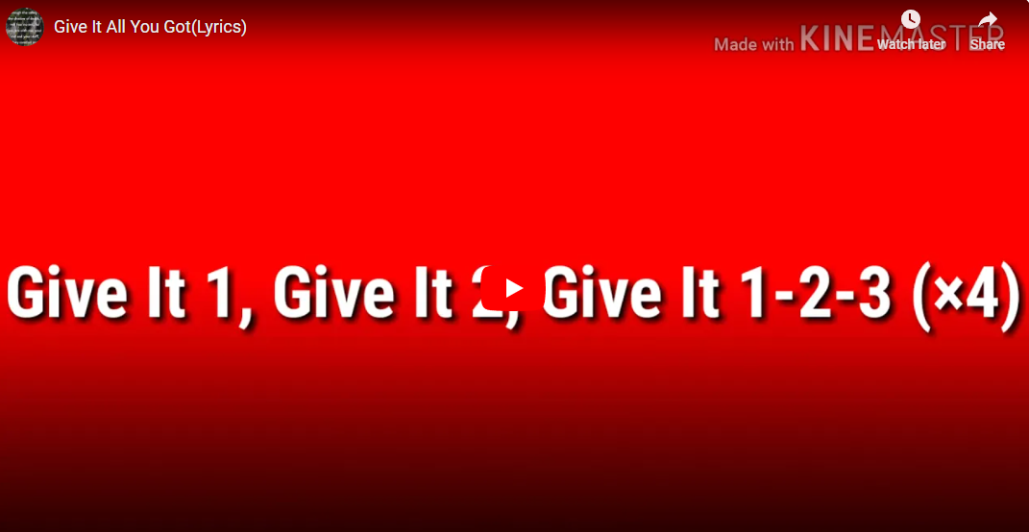
We are the children of
Hayfield Lane

Slide 11
Week 3

Slide 12
Clapping rhythms
Listen carefully
Can you complete level 1?
Can we do better than last week?

Slide 18
Today’s music
Can you remember this music from last week?
What is the pulse of the music? – the heartbeat
Listen carefully, can we find the beat? When you think you hear it, can you clap it?
A clue is at the start when the elephants start marching and they count the beat!

Slide 19
We are the children of
Hayfield Lane

Slide 20
Week 4

Slide 21
Clapping rhythms
Listen carefully
Can you complete level 1?
Can we do better than last week?

Slide 27
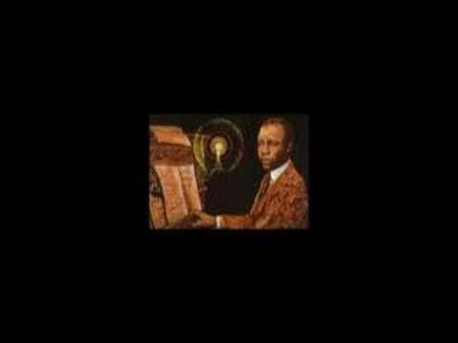
Today’s music
Listen carefully to the music – what can you hear?
Is there 1 instrument or more?
Do you think it has been made recently or in the past?
Why/ why not … can you give a reason?

Slide 28
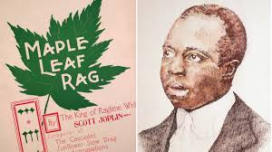
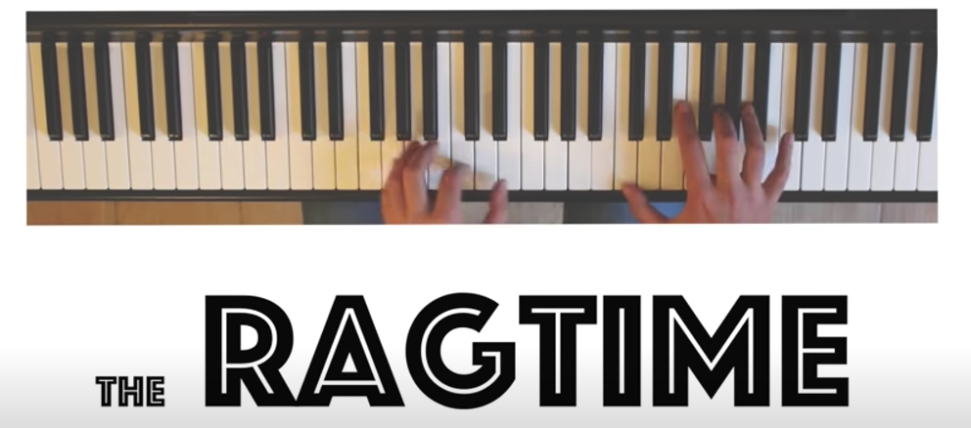
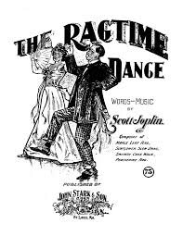
About the music
The music is called ‘Maple Leaf Rag’ and was composed by Scott Joplin
This video helps to explain HOW ragtime music is made.
(Teachers can you talk through the video whilst its playing – from 20seconds in)
https://www.youtube.com/watch?v=QTQQAWCqytE&t=127s
The genre of the music is called
‘Ragtime’
and made people feel in the mood
to dance.

Slide 29
We are the children of
Hayfield Lane

Slide 30
Week 5

Slide 31
Clapping rhythms
Listen carefully
Can you complete level 1?
Can we do better than last week?

Slide 37
Reflection
The music is called ‘Maple Leaf Rag’ and was composed by Scott Joplin
Can you remember the type of music we listened to last week?
Have a listen and see what you can remember – can you share it with the person sat next to you?
https://www.youtube.com/watch?v=pMAtL7n_-rc
The genre of the music is called
‘Ragtime’
and made people feel in the mood
to dance.

Slide 38
Reflection
Now you have heard it again, how does the music make you feel?
Does it make you want to dance or does it make you think or feel something different?
Would you play ragtime music at home? Why/Why not?

Slide 39
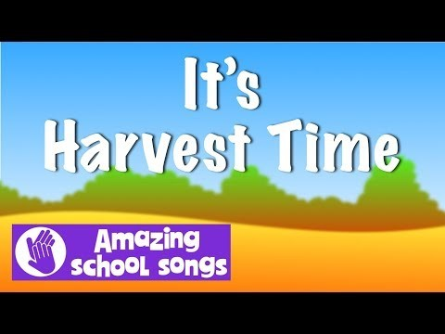
Harvest song

Slide 40
Week 6

Slide 41
Clapping rhythms
Listen carefully
Can you complete level 1?
Can we do better than last week?

Slide 47
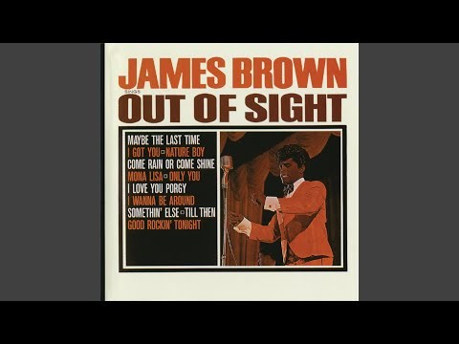
Today’s music
Listen carefully to the music – what can you hear?
Is there 1 instrument or more?
Do you think it has been made recently or in the past?
Why/ why not … can you give a reason?

Slide 48
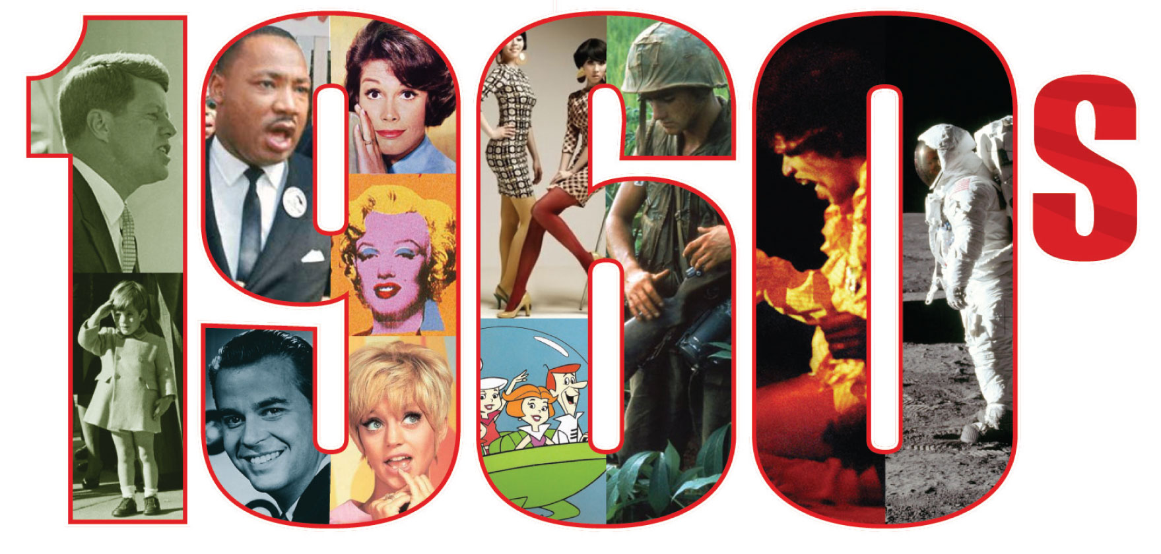
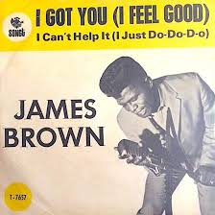
About the music
The music is called ‘I feel good’
by James Brown
It is from the 1960’s, which is in the past.
Which would you rather dance to? Ragtime or soulfunk.
Why?
The genre of the music is called
‘Soul Funk’
Like last weeks Ragtime music, it is made to get people dancing!

Slide 49
Harvest song

Slide 50
Week 7

Slide 51
Clapping rhythms
Listen carefully
Can you complete level 1?
Can we do better than last week?

Slide 57
Reflection
The music is called ‘I feel good’ by James Brown
Can you remember the type of music we listened to last week?
https://www.youtube.com/watch?v=2IoqZyho0Ys
Have a listen and see what you can remember – can you share it with the person sat next to you?
The genre of the music is called
‘Soul Funk ’
and made people feel in the mood
to dance.

Slide 58
Reflection
Now you have heard it again, how does the music make you feel?
Does it make you want to dance or does it make you think or feel something different?
Would you play soul funk music at home? Why/Why not?

Slide 59
Harvest song

