Slide 1
Music Appreciation
KS2

Slide 2
Week 1

Slide 3
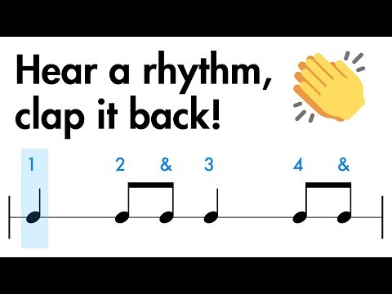
Clapping rhythms
Listen carefully
What level can we get up to? Can we get to level 3?

Slide 4
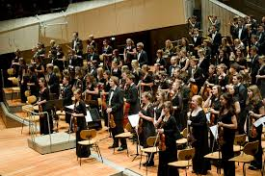
This could also be called ‘classical music’
Today we are going to listen to a piece of Traditional Western music called:
Night Ferry
By Anna Clyne
It is from the 21st Century

Slide 5
Today’s music
Listen to the music
How does the it make you feel?
Can you explain why?
What do you notice about the music?
https://www.youtube.com/watch?v=HKQAI_rNsVU

Slide 6
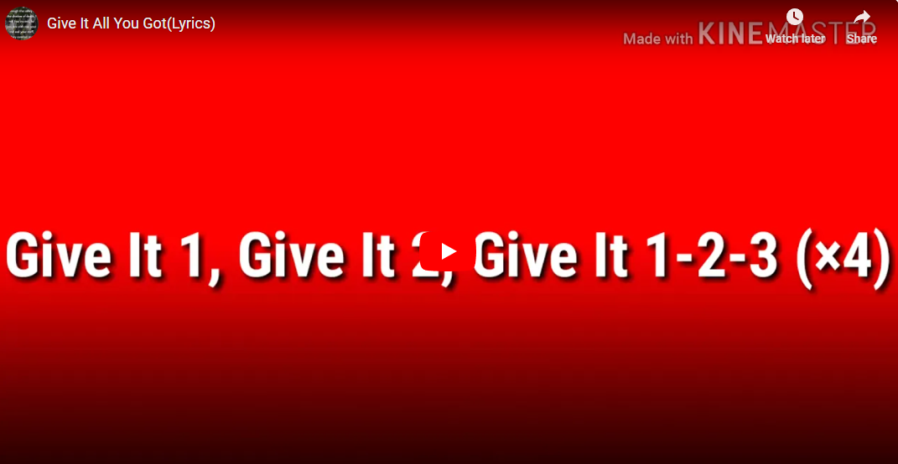
We are the children of
Hayfield Lane

Slide 7
Week 2

Slide 8
Clapping rhythms
Listen carefully
What level can we get up to? Can we get to level 3?

Slide 9
21st Century
We are going to listen to a piece of Traditional Western music called:
Night Ferry
By Anna Clyne
Can you remember when it is from?

Slide 10
Today’s music
Listen to the music again
Do you feel differently from the last time you heard it?
Can you identify any instruments within the music?
How do you know?
https://www.youtube.com/watch?v=HKQAI_rNsVU

Slide 11
We are the children of
Hayfield Lane

Slide 12
Week 3

Slide 13
Clapping rhythms
Listen carefully
What level can we get up to? Can we get to level 3?

Slide 14
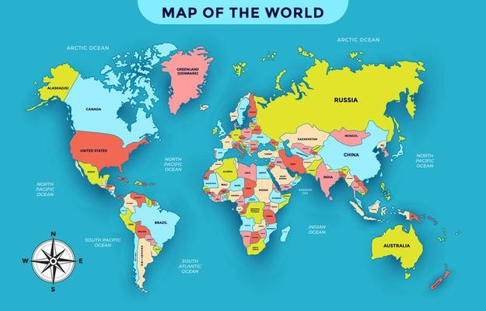
Trinidad is in the Caribbean
We are going to listen to a piece of music called:
Tropical Bird
By Trinidad Steel Band
It is Calypso music

Slide 15
Today’s music
Listen to the music- what can you hear?
What emotions do you feel when you hear it?
Does it make you want to dance?
Why/Why not?
https://www.youtube.com/watch?v=rFcq9ouzY5s

Slide 16
We are the children of
Hayfield Lane

Slide 17
Week 4

Slide 18
Clapping rhythms
Listen carefully
What level can we get up to? Can we get to level 3?

Slide 19
Where is Trinidad?
We are going to listen to a piece of music called:
Tropical Bird
By Trinidad Steel Band
Can you remember what style of music it is?
Calypso!

Slide 20
Today’s music
What instruments are in the music?
How do you know? What clues are there in the music/sounds?
Is it a fast or slow tempo? How do you know?
https://www.youtube.com/watch?v=rFcq9ouzY5s

Slide 21
We are the children of
Hayfield Lane

