Slide 1
Music Appreciation
KS1

Slide 2
Week 1

Slide 3
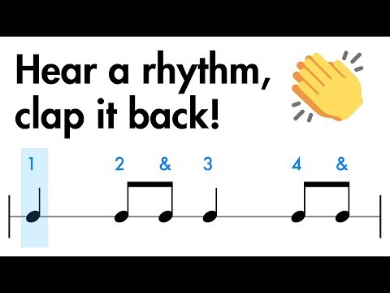
Clapping rhythms
Listen carefully
Can you remember what we did last term?
Can you repeat the patterns?

Slide 4
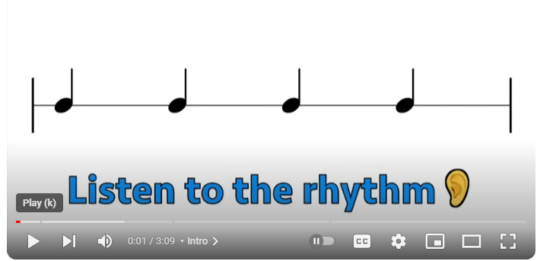

Slide 5
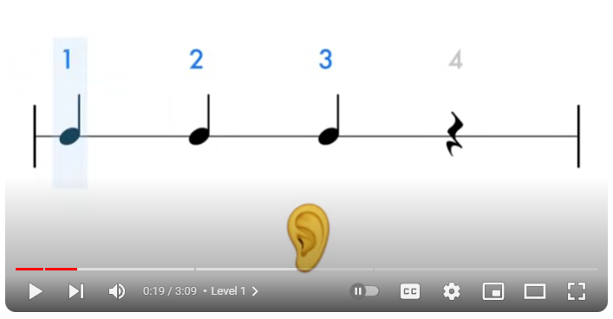

Slide 6
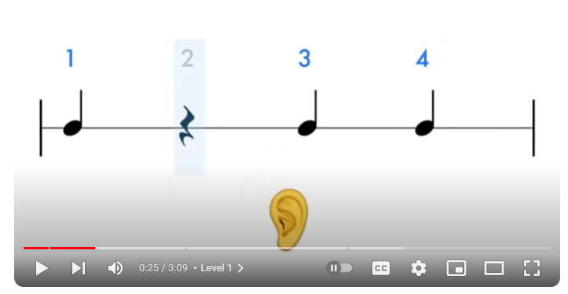

Slide 7
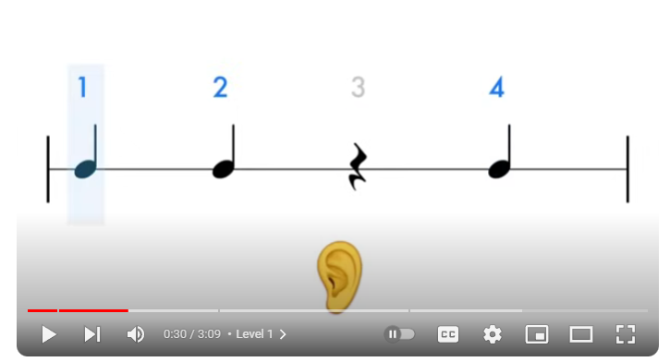

Slide 8
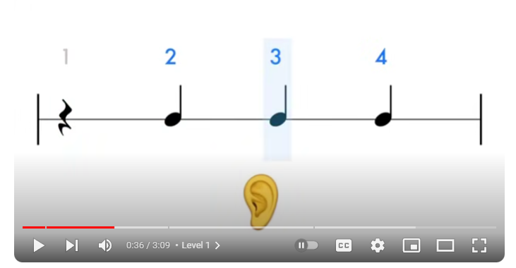

Slide 9
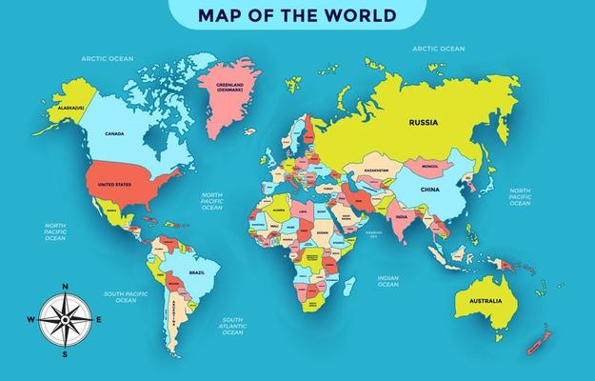
Reflection
Brazil is in South America
Today we are going to listen to some traditional Brazilian music called:
Fanfarra (Cabua-Le-Le)
By Sergio Mendes
This type of music is called
Samba

Slide 10
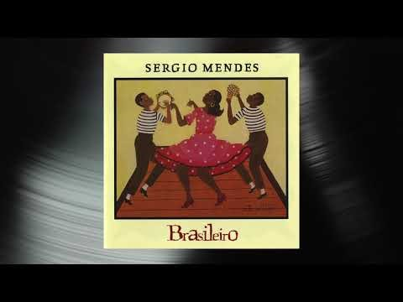
Reflection
What do you notice about the music?
Do you think there are clear parts to the music?
What are the differences within the piece of music?
Does it make you want to dance or does it make you think or feel something different?

Slide 11
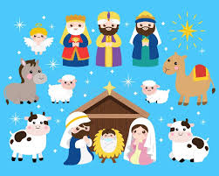
KS1 Nativity Song

Slide 12
Week 2

Slide 13
Clapping rhythms
Listen carefully
Can you remember what we did last term?
Can you repeat the patterns?

Slide 19
Reflection
Brazil is in South America
Today we are going to listen to some traditional music called:
Fanfarra (Cabua-Le-Le)
By Sergio Mendes
This type of music is called
Samba
Can you remember where the music was from?

Slide 20
Reflection
What do you notice about the music?
Can you remember what we talked about last week?
What parts are in the music?
Can we find the beat of the music? – join in with call and repeat in the first part of the song.

Slide 21
KS1 Nativity Song

Slide 22
Week 3

Slide 23
Clapping rhythms
Listen carefully
Can you repeat the patterns?

Slide 29

Reflection
Art Pop is a kind of pop music that is seen as inventive or artistically ambitious.
Today we are going to listen to a piece of music called:
Wild Man
By Kate Bush
This type of music is called
Art Pop

Slide 30
Reflection
What do you hear in the music?
How does the music make you feel?
Why?
What can you tell me about the music?
https://www.youtube.com/watch?v=a3BzjfAjug4

Slide 31
KS1 Nativity Song

Slide 32
Week 4

Slide 33
Clapping rhythms
Listen carefully
Can you repeat the patterns?

Slide 39
Reflection
Why is Art pop different to normal pop?
It is inventive/ambitious!
Today we are going to re-listen to a piece of music called:
Wild Man
By Kate Bush
This type of music is called
Art Pop

Slide 40
Reflection
What do you hear in the music?
Can you hear any instruments?
What can you hear?
What do you notice about the music?
https://www.youtube.com/watch?v=a3BzjfAjug4

Slide 41
KS1 Nativity Song

