Slide 1
Music Appreciation
KS1 – Spring 2

Slide 2
Week 1

Slide 3
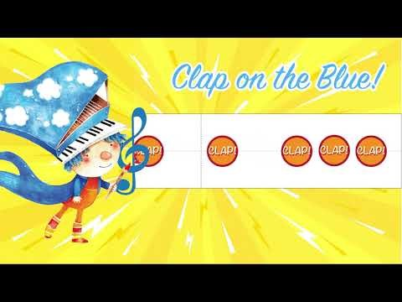
Clapping rhythms
Can you listen carefully and repeat the rhythms?
They are faster than we have been doing!
You listen on the orange, and clap on the blue.

Slide 4
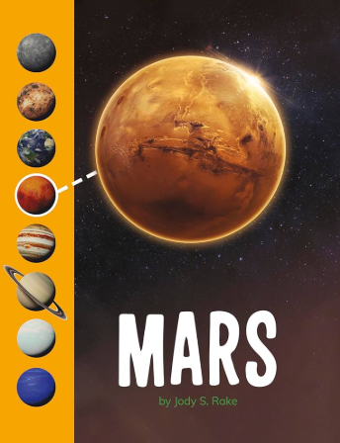
Reflection
Today we are going to listen to some popular music called:
Mars (from The Planets)
By Gustav Holst
This type of music is from the
20th Century

Slide 5
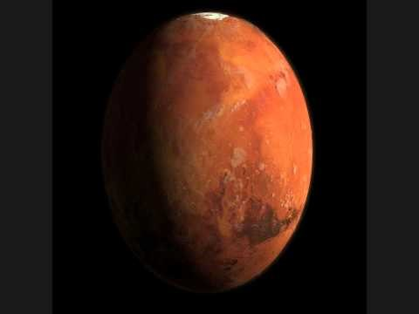
Reflection
Before we listen, what do you think the music will be like and why? (think about the planets)
What do you notice?
How did it make you feel?
Do you think the other planets in the movement of music will sound the same/different? Why?
https://www.youtube.com/watch?v=Jmk5frp6-3Q

Slide 6

Hayfield Lane Song
https://www.youtube.com/watch?v=oJmyY2yR9sw

Slide 7
Week 2

Slide 8
Clapping rhythms
Can you listen carefully and repeat the rhythms?
They are faster than we have been doing!
You listen on the orange, and clap on the blue.

Slide 9
Reflection
Today we are going to listen to some popular music called:
Mars (from The Planets)
By Gustav Holst
This type of music is from the
20th Century

Slide 10
Reflection
Think back to last week – what did we think about the piece of music?
Listen again, can you identify any instruments?
What volume/tempo runs through the piece, and what does that do/what feeling does it create?
https://www.youtube.com/watch?v=Jmk5frp6-3Q

Slide 11
Hayfield Lane Song
https://www.youtube.com/watch?v=oJmyY2yR9sw

Slide 12
Week 3

Slide 13
Clapping rhythms
Can you listen carefully and repeat the rhythms?
They are faster than we have been doing!
You listen on the orange, and clap on the blue.

Slide 14
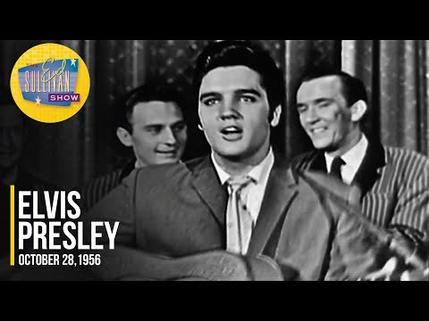
Reflection
https://www.youtube.com/watch?v=aNYWl13IWhY
Based on the video, when do you think this music/song is from? Why?
Would this be on TV today? Why/why not?
What instruments can you see?
What do you notice?

Slide 15
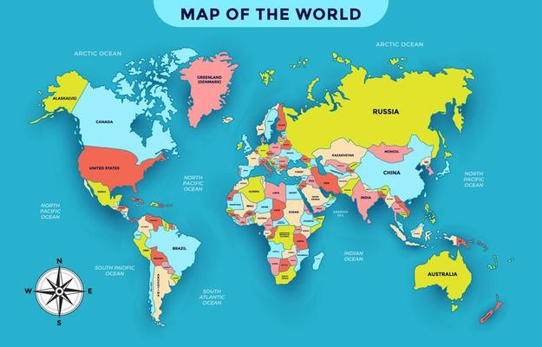
Reflection
Rock & roll music evolved in the USA in the 1940’s & 1950’s
The music you listened to is called
Hound Dog
By Elvis Presley
This genre of music is
Rock and Roll

Slide 16
Hayfield Lane Song
https://www.youtube.com/watch?v=oJmyY2yR9sw

Slide 17
Week 4

Slide 18
Clapping rhythms
Can you listen carefully and repeat the rhythms?
They are faster than we have been doing!
You listen on the orange, and clap on the blue.

Slide 19
Reflection
Rock & roll music evolved in the USA in the 1940’s & 1950’s
This week the music is called
Hound Dog
By Elvis Presley
This genre of music is
Rock and Roll

Slide 20
Reflection
https://www.youtube.com/watch?v=aNYWl13IWhY
After listening once, can you clap along to the pulse of the music when listening a second time?
Is the music tempo fast (allegro) or slow (adagio)?
What does it make you feel?

Slide 21
Hayfield Lane Song
https://www.youtube.com/watch?v=oJmyY2yR9sw

Slide 22
Week 5

Slide 23
Clapping rhythms
Can you listen carefully and repeat the rhythms?
They are faster than we have been doing!
You listen on the orange, and clap on the blue.

Slide 24
Reflection
Indian classical music originated in South Asia over 6000 years ago and is one of the worlds oldest musical traditions
This week the music is called
Sahela Re
By Kishori Amonkar
This type of music is
Indian Classical

Slide 25
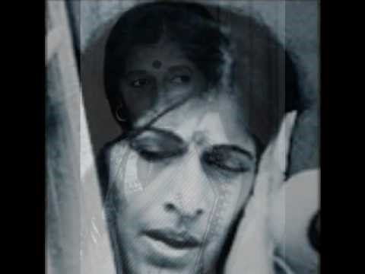
Reflection
https://www.youtube.com/watch?v=ipauyMfVYso
What do you think to the music?
Can you pick out the underlying rhythm in the music that goes all the way through?
How does the vocalist use her voice as an instrument?

Slide 26
Hayfield Lane Song
https://www.youtube.com/watch?v=oJmyY2yR9sw

