Slide 1
Music Appreciation
KS2

Slide 2
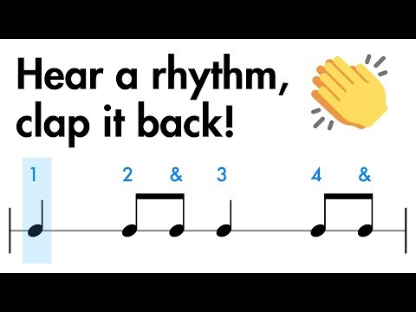
Clapping rhythms
Listen carefully
What level can we get up to? Can we get to level 3?

Slide 3
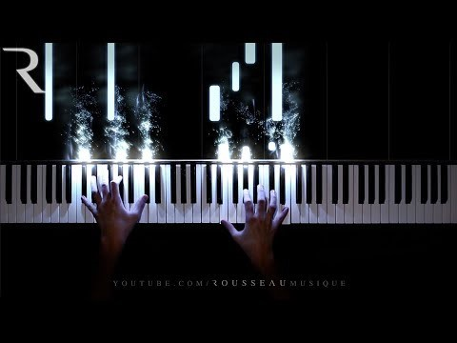
Today’s music
Listen to the music
What instrument do you think is being played?
How does the music make you feel?
Can you explain why?

Slide 4
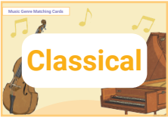
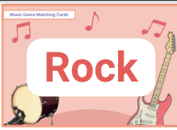
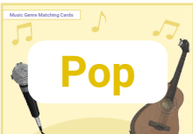
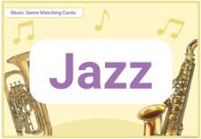
Today music
What type of music do you think it is? Why/Why not?

Slide 5
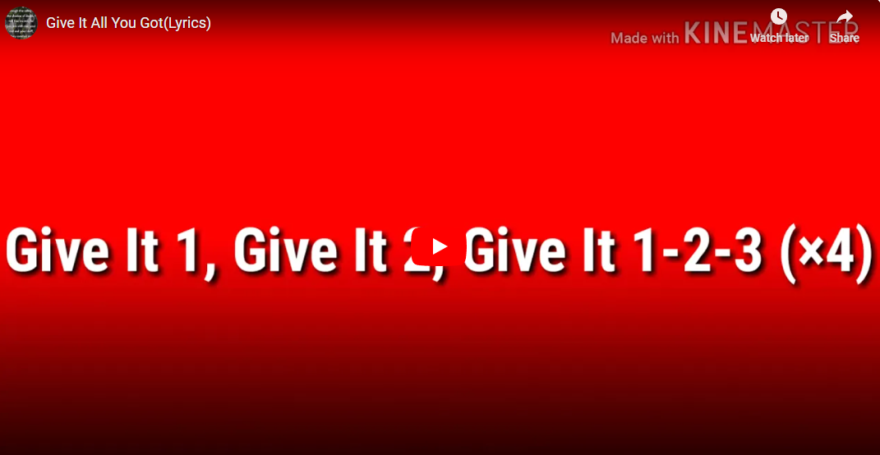
We are the children of
Hayfield Lane

Slide 6
Clapping rhythms
Listen carefully
What level can we get up to? Can we get to level 3?

Slide 7
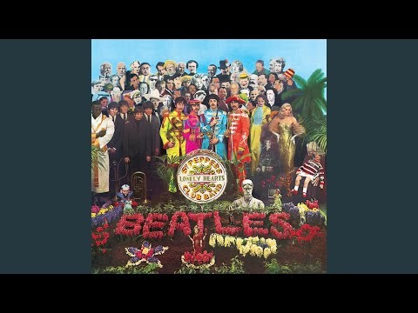
Today’s music
Listen to the music
What is the pulse of the music? – the heartbeat
Listen carefully, can we find the beat? When you think you hear it, can you clap it?
If you think back to last week, do you think it is the same genre or different?

Slide 8
Today music
What type of music do you think it is? Why/Why not?

Slide 9
We are the children of
Hayfield Lane

